Slide 1

BANK TERM DEPOSITS ANALYSIS & PREDICTION

Slide 2
Introduction
Term deposits are a type of fixed investment where customers deposit money with a financial institution for a predetermined period at an agreed interest rate. These deposits are a reliable and significant source of income for banks, as they provide a stable inflow of funds while offering customers a secure way to grow their savings.

Slide 3

Business Problem
Telephonic marketing is an effective but costly method for promoting term deposits. To optimize resources and improve conversion rates, the bank needs to identify customers most likely to subscribe to a term deposit before reaching out, ensuring more targeted and cost-efficient marketing efforts.

Slide 4

Objectives
1. Identify Key Predictors: Analyze customer demographics, previous interactions, and campaign details to determine the most important factors influencing a customer’s decision to subscribe to a term deposit.
2. Develop the Best Prediction Model: Build and evaluate multiple classification models to identify the most accurate model for predicting whether a customer will subscribe to a term deposit, ensuring optimal performance.
3. Optimize Marketing Strategies: Use the insights from the model to recommend targeted telephonic marketing strategies, focusing on high-potential customers to maximize conversion rates and reduce unnecessary outreach.

Slide 5
Metrics of success
1. Model Accuracy: Achieve over 80% accuracy in predicting customer subscription to a term deposit.
2. Precision & Recall: High precision and recall for identifying customers likely to subscribe (Class 1).
3. Feature Importance: Identify key factors influencing subscription decisions to optimize marketing strategies.
4. Conversion Rate: Increase conversion rates by targeting high-potential customers.
5. Outreach Efficiency: Reduce unnecessary outreach to non-potential customers.
6. Cross-validation Performance: Ensure consistent performance across different data subsets to avoid overfitting.

Slide 6
Dataset Overview
This dataset is related to the direct marketing campaigns of a Portuguese banking institution. The marketing campaigns were conducted through phone calls, often requiring multiple contacts with the same client to determine whether they would subscribe to the product (bank term deposit).
Data source: https://www.kaggle.com/datasets/thedevastator/bank-term-deposit-predictions?resource=download
The target variable indicates whether the client subscribed (`"yes"`) or not (`"no"`).
The data folder contains two datasets:
- train.csv: Contains 45,211 rows and 18 columns, ordered by date (from May 2008 to November 2010).
- test.csv: Contains 4,521 rows and 18 columns, representing 10% of the examples, randomly selected from `train.csv`.

Slide 7
Column Description
1. age`: Age of the client (numeric).
2. job`: Type of job (categorical: `"admin."`, `"unknown"`, `"unemployed"`, `"management"`, `"housemaid"`, `"entrepreneur"`, `"student"`, `"blue-collar"`, `"self-employed"`, `"retired"`, `"technician"`, `"services"`).
3. `marital`: Marital status (categorical: `"married"`, `"divorced"`, `"single"`; note: `"divorced"` includes divorced or widowed).
4. `education`: Level of education (categorical: `"unknown"`, `"secondary"`, `"primary"`, `"tertiary"`).
5. `default`: Has credit in default? (binary: `"yes"`, `"no"`).
6. `balance`: Average yearly balance in euros (numeric).
7. housing`: Has a housing loan? (binary: `"yes"`, `"no"`).
8. `loan`: Has a personal loan? (binary: `"yes"`, `"no"`)

Slide 8
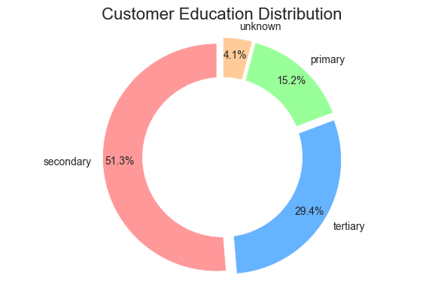
Exploratory Data Analysis
Most customers had attained Secondary school level of education i.e., 51.3% followed by those with Tertiary level of education at 29.4%

Slide 9
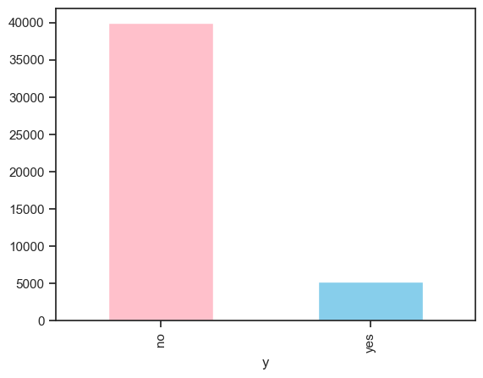
Analysis of ‘y’ Target Variable
Majority of customers were non-subscribers to term-deposits

Slide 10

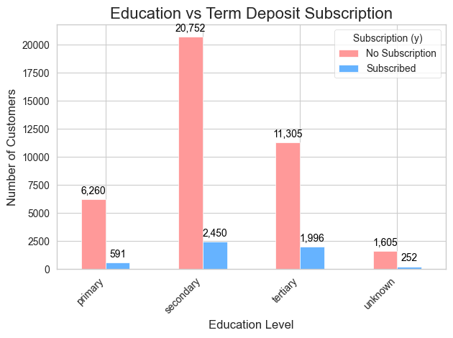
Education level vs Deposit Subscription
Customers with Secondary school education level comprised the majority of those who had subscribed to term deposits followed by those with tertiary level of education.

Slide 11
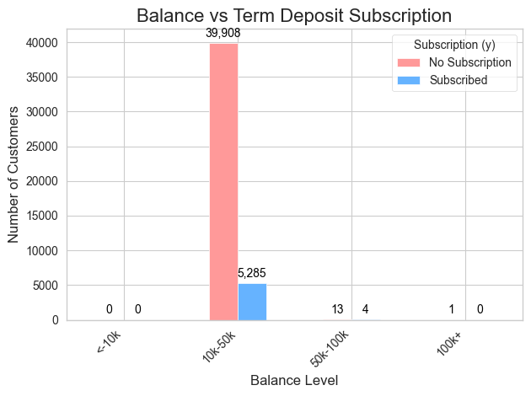
Bank account Balance vs Term deposit subscription
Customers with bank account balance between 10K-10K formed the majority of those who subscribed to term deposits and this category of customers also comprised super majority of the non-subscribers

Slide 12
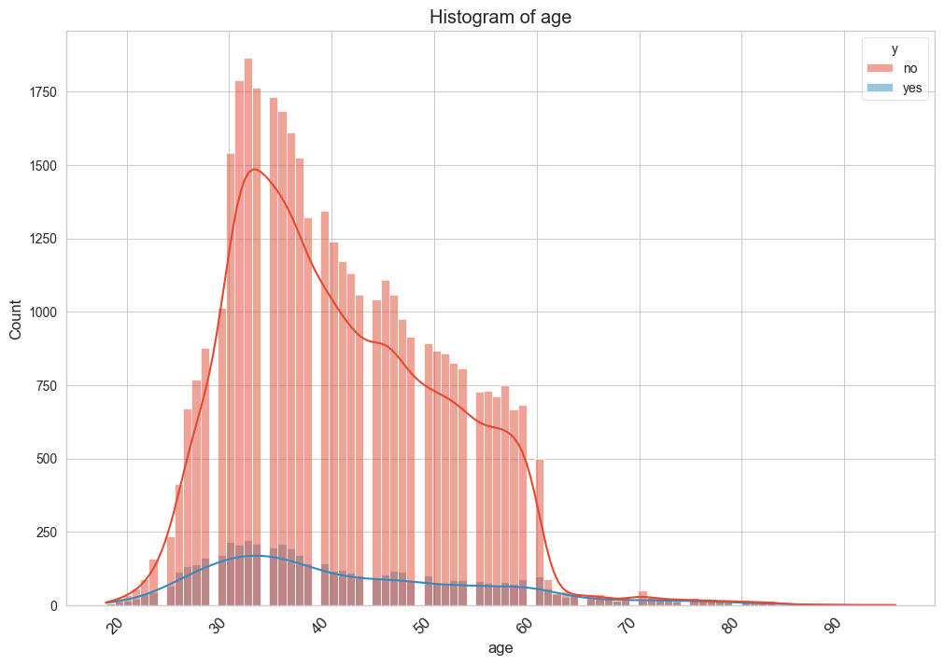
Distribution of Age
Close the gap
Target audience
Cost savings
Easy to use

Slide 13
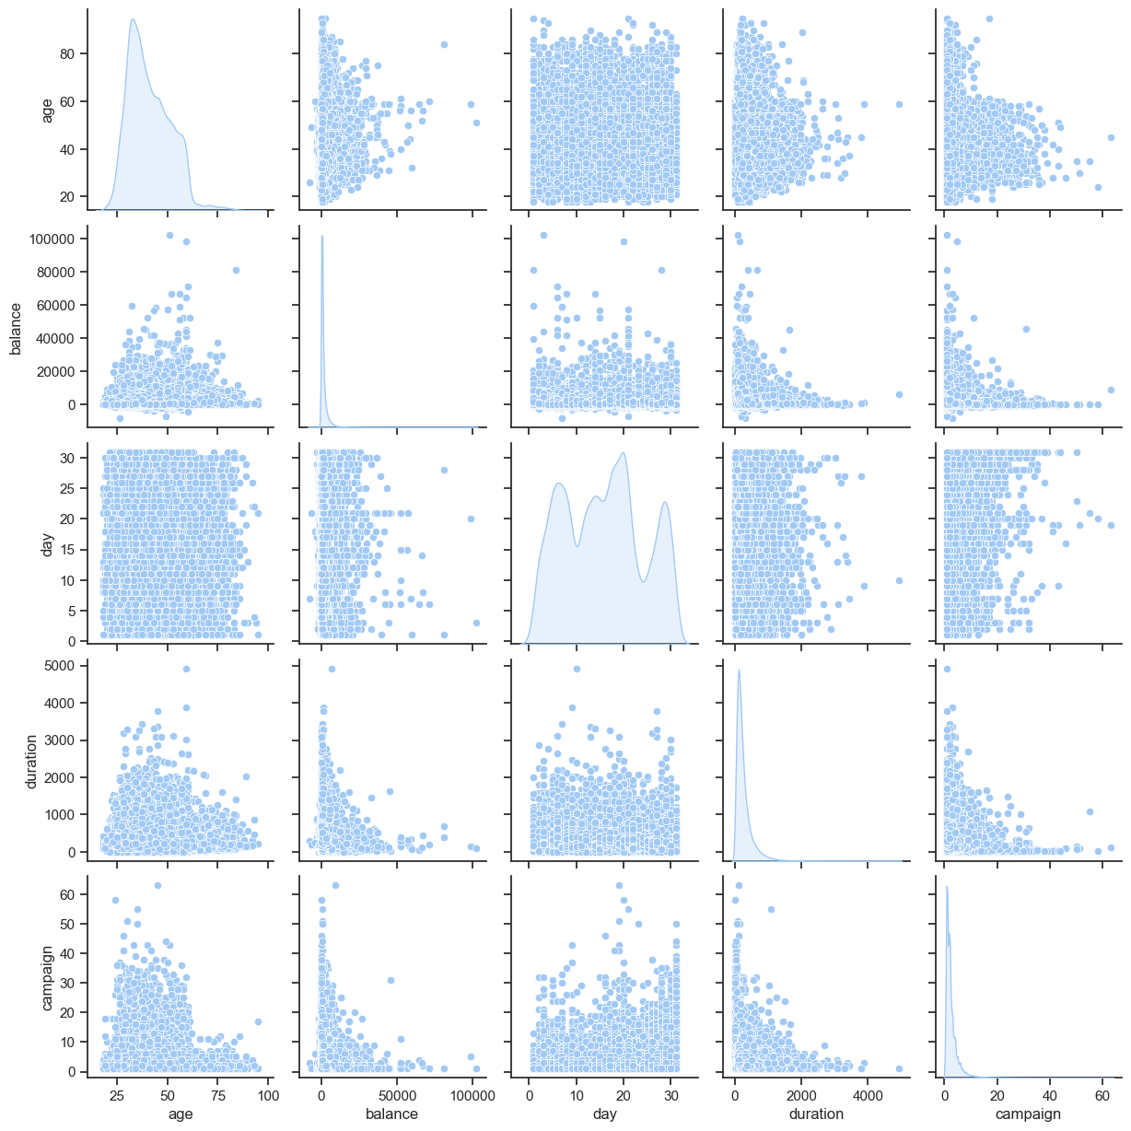
Pair plots

Slide 14
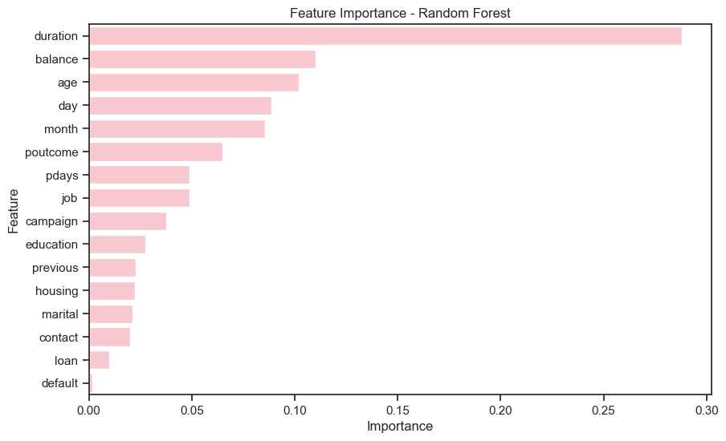
Feature importance
Less important features include Default, loan, contact & Marital status
Most important features include Duration, Balance and Age

Slide 15
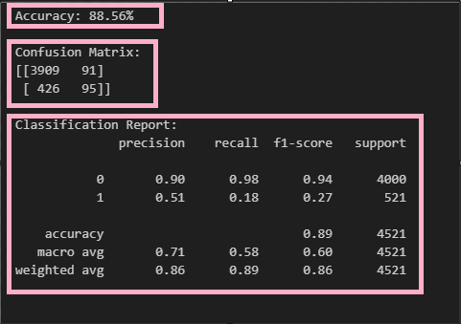
Base Model: Logistic Regression Model
MODEL PERFOMANCE EVALUATION

Slide 16
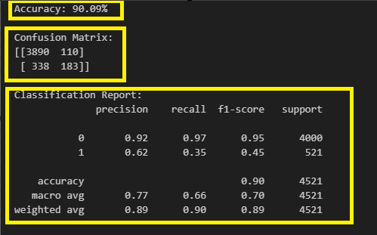
KNN Model

Slide 17
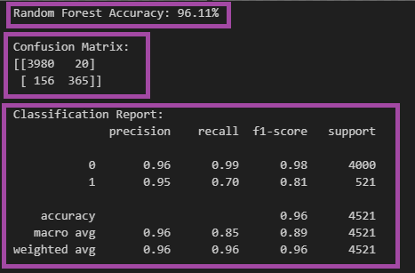
RANDOM FOREST MODEL
1. Accuracy: The model performs similarly on both training and test sets, with a slight increase in accuracy on the test set (96.11% vs. 95.96%).
2. Class 0 (Negative class):
- High precision, recall, and F1-score on both sets, showing the model is very effective in correctly identifying the negative class.
3. Class 1 (Positive class):
- Slight decrease in recall for Class 1 on the test set (70% vs. 68%), indicating the model is slightly better at identifying positive cases in the test set.
- Precision for Class 1 remains very similar between the training and test sets (around 0.95–0.97).

Slide 18
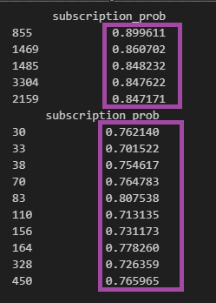
PREDICTING PROBABILITY OF SUBSCRIPTION FOR EACH CUSTOMER

Slide 19
CONCLUSIONS
- Key Factors: Duration of the call, balance, and age are the strongest predictors.
- Campaign Timing: The day, month, and timing of contact matter for successful subscriptions.
Demographics and Financial Stability: Job type and balance are secondary but important indicators.
Random Forest The model generalizes well from training to testing with consistent performance(96.11%), particularly in predicting the negative class (Class 0). The slight improvement in recall for the positive class (Class 1) on the test set may indicate better generalization or data characteristics in the test set. The model seems well-calibrated with no significant overfitting or underfitting.
Customers with high `subscription_prob` values (e.g., 0.892162, 0.871691, 0.870282) have a high likelihood of conversion.
- Customers with `subscription_prob` values between 0.75 and 0.80 represent the next tier of likely conversions. While not as urgent as the highest-probability customers, this segment still holds significant potential and should be targeted with focused outreach.

Slide 20
RECOMMENDATIONS
- Focus on longer, high-quality interactions
- Tailor campaigns based on age and balance.
- Utilize personalized outreach strategies to improve subscription rates.
- Focus on Random Forest for its overall performance and improve recall for the minority class by addressing class imbalance and tuning model parameters.
- Target High-Probability Customers: Focus marketing efforts on customers with high `subscription_prob` (e.g., 0.892162, 0.871691, 0.870282). These customers are highly likely to subscribe, requiring minimal outreach for better conversion rates.
- Use a Probability Threshold: Consider customers with probabilities around 0.75–0.80 for the next tier of targeted outreach. While not as urgent as the highest-probability customers, they still represent a valuable segment to target.
- Optimize Resource Allocation: Allocate resources efficiently by prioritizing customers with probabilities above 0.8. This ensures higher conversion rates with less effort on low-probability customers.
- Reduce Unnecessary Outreach: Deprioritize customers with lower probabilities (e.g., 0.716083, 0.725284), or approach them with different strategies, such as offering incentives or alternate products.

Slide 21
Thank you
Richard Mokaya
+254707751916
rmokaya1@gmail.com

